Slide 1
James Webb Telescope
HOLIDAY BINGO
PLAY!

Slide 2
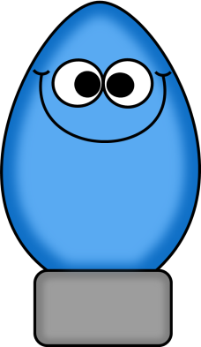
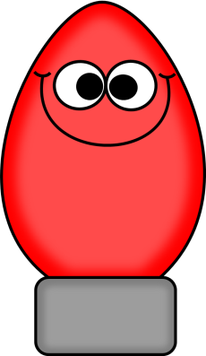
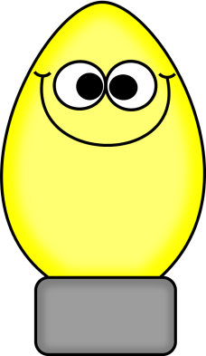

Slide 3
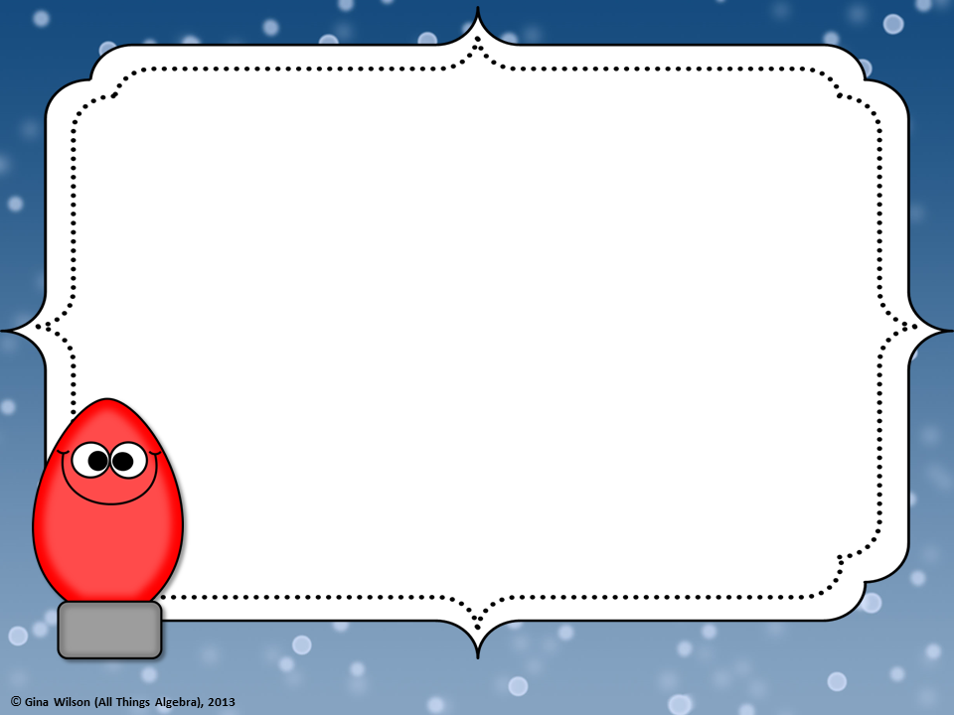
1
Name one innovation of
the JWST
Microshutters
ANSWER
BACK

Slide 4
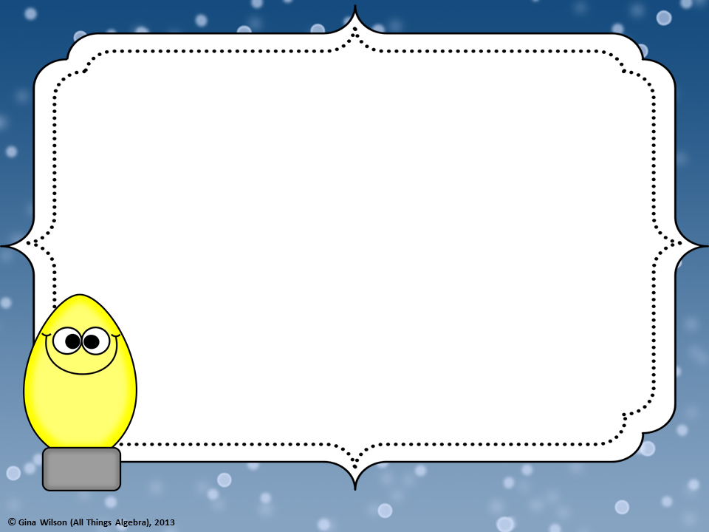
2
When is the JWST expected
to launch?
March 30th, 2021
ANSWER
BACK

Slide 5
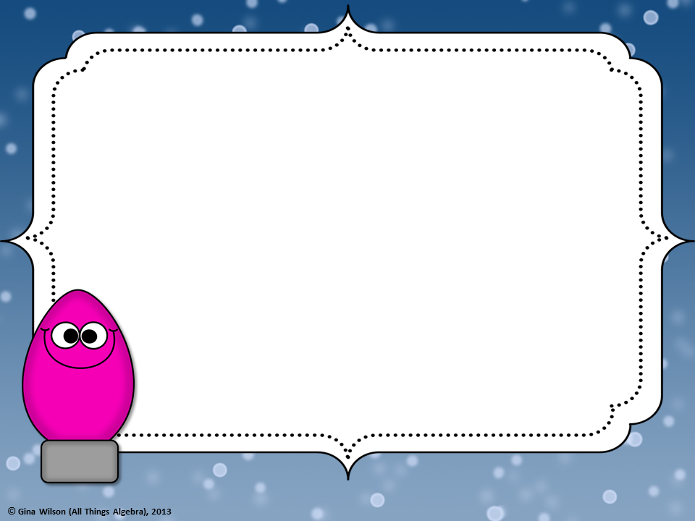
3
When completely unfurled,
how wide will the Webb’s
primary mirror span to?
Over 21 feet
ANSWER
BACK

Slide 6
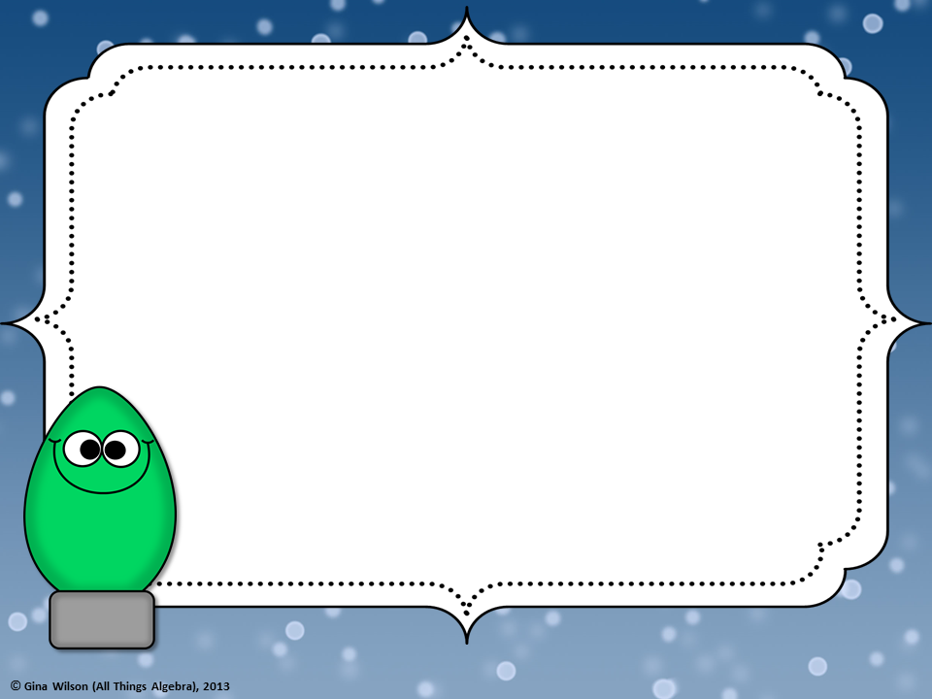
4
Where is the JWST
launch site?
Near Kourou, French Guiana
ANSWER
BACK

Slide 7
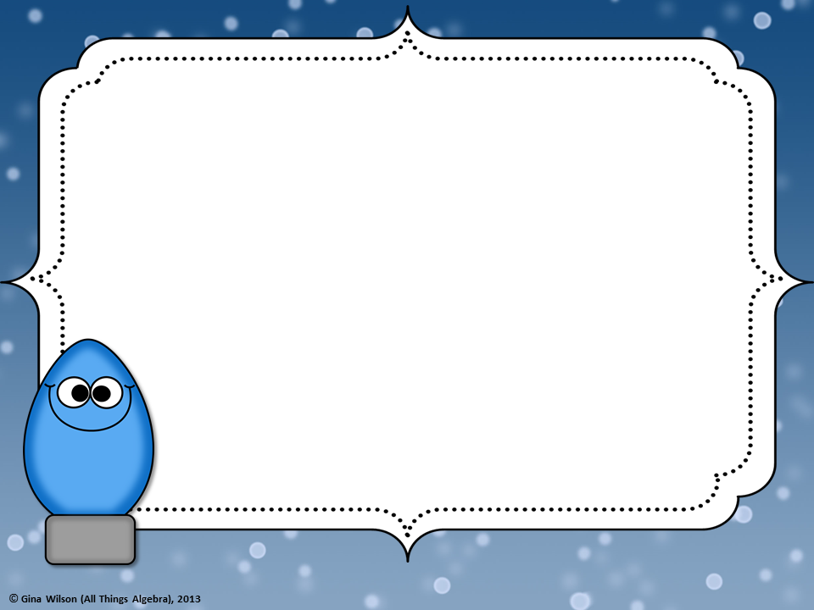
5
What is the goal of the
Webb’s first study?
To gain knowledge of
Dark matter.
ANSWER
BACK

Slide 8
6
About how much $
does the JWST cost?
About $8.7 billion
ANSWER
BACK

Slide 9
7
Fill in the blank:
The JWST mirror is designed
to collect ______ light.
Infrared
ANSWER
BACK

Slide 10
8
How many gold-plated mirrors
JWST contain?
18 gold plated mirrors
ANSWER
BACK

Slide 11
9
Name one thing that Webb’s
world class science can do.
It can shed light on the many
mysteries of the universe.
ANSWER
BACK

Slide 12
10
Webb has a giant, tennis court-
sized sunshield made up of
how many layers?
5 layers
ANSWER
BACK

Slide 13
11
True or False:
Webb will be folded, origami-
style, before launch.
True
ANSWER
BACK

Slide 14
12
What galaxy will the JWST
be launched into?
The Milky Way Galaxy
ANSWER
BACK

Slide 15
13
When was the JWST initially
supposed to launch?
2018
ANSWER
BACK

Slide 16
14
What does NASA stand for?
National Aeronautics and
Space Administration
ANSWER
BACK

Slide 17
15
How many lbs. will the JWST
weigh? 14,000 lbs., or 3 tons?
14,000 lbs.
ANSWER
BACK

Slide 18
17
Fill in the blank:
Because of its size and complexity,
the process of integrating and testing
parts, is more ___________ than that
of an average science mission.
(simple, or complicated.)
Complicated
ANSWER
BACK

Slide 19
18
Webb is an international
project led by NASA with its
partners, the European Space
Agency and the ______.
Canadian Space Agency
ANSWER
BACK

Slide 20
16
Fill in the blank:
If dark matter is _______ its
density will be very near the
centers of the galaxies. Cold
or warm?
Cold
ANSWER
BACK

Slide 21
19
True or False:
The JWST will be orbiting
the Earth just like the Hubble.
False
ANSWER
BACK

Slide 22
20
True or False:
The JWST is worth the wait.
True
ANSWER
BACK

Slide 23
21
What instrument did
Mrs. Smith play growing up?
The Flute
ANSWER
BACK

Slide 24
22
What is the largest
structure of the JWST?
The Sunshade
ANSWER
BACK

Slide 25
23
What are the 5 layers of the
sunshade each separated by?
A Vacuum
ANSWER
BACK

Slide 26
24
Fill in the blank:
The combined gravitational
forces of the ________ and ________ helps
hold the spacecraft almost still.
The Sun and Earth
ANSWER
BACK

Slide 27
25
What NFL team is
Mrs. Smith’s favorite?
The SEAHAWKS
ANSWER
BACK

